Slide 1
Assignment 4
Concept Video
CS 147
10.18.2024

Slide 2

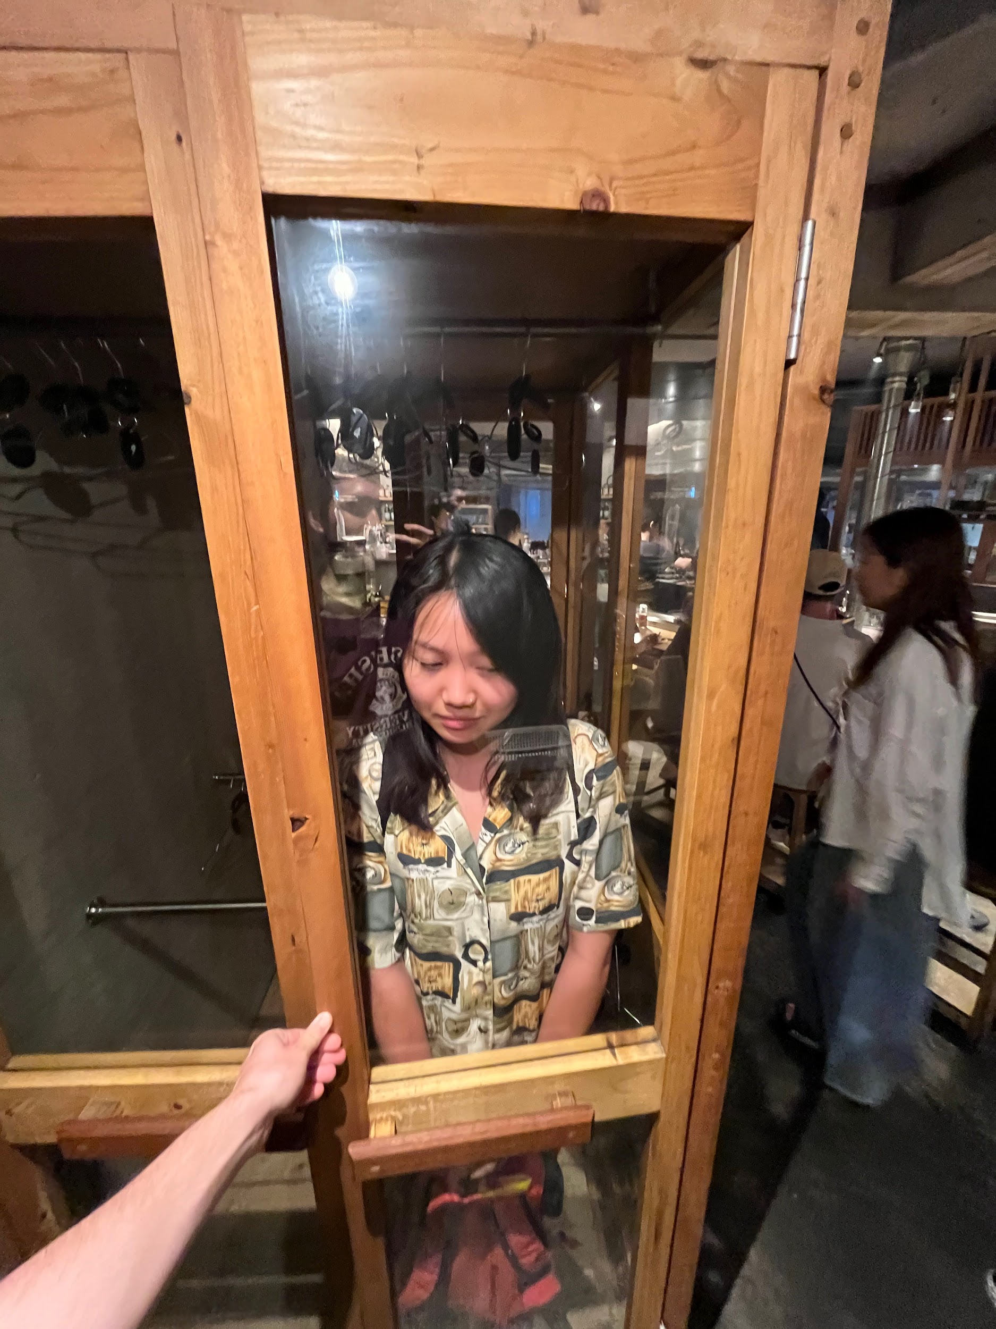

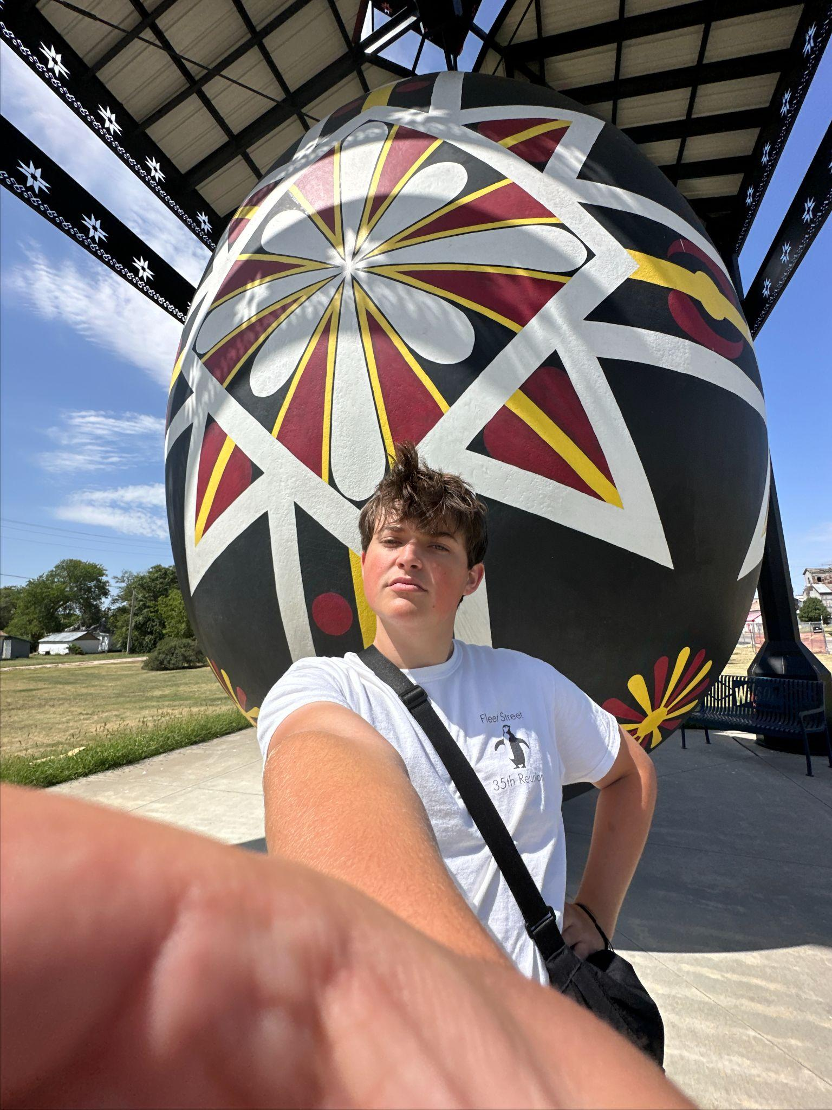
∞ Mora ∞
Bryant
Candy
Lulu
Tommy
Senior
Computer Science
Senior
Urban Studies
Junior
Computer Science
Junior
Undeclared

Slide 3
ROADMAP -
01
02
03
04
05
06
Pivoting
New Solution
Market Research
Changes since last week
One liner, Description, Value Proposition, Design Values: (Stakeholders, Ethics)
Competitive Analysis
Tasks
Storyboard
Concept Video
Explanations & Time Approximations in Video
The skeleton of our concept video!
Get excited about Mora!

Slide 4
01
Pivoting

Slide 5
Journey since last week
Implementation feasibility? Unclear thread from POV -> HMW -> Solution
Nora’s thread felt the most compelling to us!
Feedback about our proposed solution
New solution!
1
2
3
4
Decided on a proposed solution
Back to the drawing board…
Stories situated in the cultural context of the target language. Learn as you read!
We want a solution that clearly arises from our needfinding with interviewees.
Notes:
Before receiving feedback last week, we decided to move forward with our first solution, which allow users to learn vocabulary as they move through stories that are situated in the cultural context of the target language. As a group, we felt the most excited about this solution. However, after taking into account the feasibility of implementing this solution, as well as feedback about the fact that this solution did not seem to generate naturally from Anna’s POV and HMW, we decided to go back to the drawing board and see if there’s another solution that served our interviewees more. Throughout the needfinding process, we were always drawn to Nora’s story and decided that we wanted to hone in on that. Ultimately, we decided to pivot to solution 2, which integrates language learning into media consumption through lessons that interrupt the media consumption experience.

Slide 6
02
New Solution!

Slide 7

Notes:
Meet Mora!

Slide 8
More on Mora - Problem/Solution Overview
The value proposition of Mora is to save the language learner of all levels from the tedious, decontextualized language learning techniques of old. Mora is a companion for streaming which interrupts your watching with live language lessons and links to an app which summarizes your stats, curates review material for your favorite shows, and connects you to interest-based communities of language learners to bond and/or compete live with.
Notes:
Primary User: Language learner of all levels
Problem that we’re tackling: Tedious, decontexualized language learning techniques.
Synopsis of proposed solution:

Slide 9
Mora
Why Mora? Mora is the latin word for pause
A central feature of our project is that it pauses your entertainment for learning
Additionally, it seeks to make language learning a “pause” — a restful, restorative activity — the way entertainment is
More amusement. More acquisition. Mora.
Notes:
How did we land on the name Mora?

Slide 10
02.5
Values in Design
Notes:
This was our second proposed solution.

Slide 11
Stakeholder Analysis
Direct
Indirect
Streaming platforms
Media consumers
Language learners
Media creators
Language teachers
Speakers of user’s target language
Travel/tourism industry
User’s classmates, friends, or family
Notes:
DIRECT:
Streaming platforms: our product affects the traffic to and from their platform, thus impacting the user experience they craft, and it has to be technologically compatible, which impacts their internal operations as well.
Media consumers: this product would alter the way (some) people consume their media — in a way that may be annoying or inconvenient to some but might be a fresh, exciting experience for others
Language learners: for language learners interested in switching up their learning methods, this would provide an outlet, but for language learning traditionalists, this product might be controversial.
INDIRECT:
Media creators: While actors, directors, producers, and other “Hollywood” people wouldn’t direct interact with our technology, their craft and how people interact with it would very much be affected, which they may or may not appreciate
Language teachers: While we don’t propose this as a substitute for second language studies in school, people may misuse it to that effect. Alternatively, without giving ourselves too much credit, this may affect the way language is taught more broadly
Speakers of user’s target language: Primarily they hold stake in our technology because if it is successful it will connect them to more people. Furthermore, this alternate method of learning may actually change that experience of connection and communication relative to traditional language learning
Travel/tourism industry: It is likely the case that affecting people’s interest in second language learning has a ripple effect on their interest in traveling or where they wish to travel
User’s classmates, friends, or family: As simply as our product has an interest in our users’ time, it has an impact on those around them. Furthermore, our product might spark curiosity or conversation that moves through these channels

Slide 12
Tarot Cards of Tech

Slide 13
The Siren
Ethical Implication: does this product, by encouraging excessive media consumption, promote unproductive, antisocial behavior?
Tension: Integrating learning with media makes its content more human-centered (more relevant and contextual) but actually makes it a less “human-involved” (social) interaction
The intention is to take advantage of an “unproductive behavior” that people already do to be productive while still having fun
When we imagine our user base, this product doesn’t replace a human:
Kids, teens — we see this as a supplement, not a substitute, to classroom learning
Adults — probably replacing self-studying practice like Duolingo
We should center the social experience—the interest communities and live watch parties
We could also encourage and craft an experience for in-person multiperson TV-watching
Notes:
Making TV educational is a pretty unequivocal good, but Mora still encourages watching TV, which in excess has more mixed implications → ethical implication

Slide 14
The Forgotten
Ethical Implication: does this product exclude people who don’t have access to subscription-based streaming platforms?
Tension: This places our values of entertainment and education at odds with accessibility.
The contextual, socially relevant type of language learning Mora empowers has larger barriers to entry otherwise (connections to fellow language speakers)
We need to ensure that Mora has support for free platforms such as YouTube
Potentially the app, with review material organized by media, could be accessible regardless of whether you engage with the media-mediated language lessons
Notes:
Because media consumption is so commodified, this companion to streaming by extension excludes people who don’t have access to these payed platforms.
Similarly, people who don’t have access to or comfort with technology wouldn’t be able to take advantage of Mora
Within the realm of entertainment, it is hard to be completely cost-free. With the exception of internet user-created content, most entertainment has some cost.

Slide 15
03
Market Research
Who are our competitors?

Slide 16

Duolingo
“The free, fun, and effective way to learn a language!”
Duolingo is an app/website that facilitates language learning through stories, leaderboards, streaks, games.
What has worked?
Gamification help create a continued interest in engaging with content
Short & manageable lessons
Accessible entry point for beginners
What hasn’t worked?
Exercises lack context
Unengaging stories
Doesn’t prepare for real-life communication
Pressure to keep up is a bigger motivator than genuine interest in language – can start to feel like a chore
Leaderboard does little to incentivize collaboration to learn words and slang together

Slide 17

Sabi
“Turn your favorite show into a language learning game”
Sabi is a browser extension that interrupts your watching with exercises in your target language.
What has worked?
Customizability: types of exercises and language skill to improve
Integrates learning into entertainment
Adaptive learning: continuous assessments of language level and adjusts difficulty accordingly
What hasn’t worked?
Difficult navigation: frustrating UI
Irrelevant translations: system sometimes asks for translation of random, unrelated words that are not useful for expanding vocabulary
Quiz indicators lack clear signals – users might be caught off guard -> bad user experience

Slide 18

Chatty
“Learning language in community”
Chatty is a former 147 project that connects language learners with native speakers of their language.
What has worked?
Allows people to connect with other humans who are interested in their target language
Learn relevant conversational skills
Teaches language with proper social and cultural context
What hasn’t worked?
Conversations between members are only based on language, so they may be awkward and 1 dimensional
Requires effort and motivation from both learners and native speakers to sign up

Slide 19

LangVRse
“Immerse yourself in a new language and culture!”
LangVRse is a former 147 project that uses VR to immerse language learners in the country that a language is spoken in, where they can complete activities and converse with native speakers.
What has worked?
Allows people to learn from native speakers
Adds cultural context to language learning
Makes language learning feel fun
What hasn’t worked?
Vocab is less personalized towards individual learners’ interests
Lack of customization and adjustment of difficulty based on learners’ abilities
Accessibility: Not accessible for those without VR headsets

Slide 20
Adapts to users’ skill level | ✅ | ✅ | ✅ | ❌ | ❌
Fosters community | ✅ | ❌ | ❌ | ✅ | ❌
Lessons with cultural, linguistic, social context | ✅ | ❌ | ✅ | ✅ | ✅
Customizable interactions (areas of focus) | ✅ | ❌ | ✅ | ❌ | ❌
Enjoyable, seamless learning experience (effort, UI, UX) | ✅ | ✅ | ❌ | ❌ | ✅
Notes:
Mora offers a solution that fills niches that many of our competitors fail to address. Community, customizability, ease of access, and enjoyability are all crucial aspects of language learning that Mora emphasizes.

Slide 21
Mora offers a solution that fills niches that many of our competitors fail to address! Community, customizability, ease of access, social and linguistic context, and enjoyability are all crucial aspects of language learning that Mora emphasizes.

Slide 22
04
Tasks
Who are our competitors?

Slide 23
Simple Task #1
Engage with entertainment of choice and learn from the interactive lesson.
Nora wants to work on her Mandarin but was planning on watching TV tonight, so she begins an interactive lesson to practice grammar and learn vocab while watching the show.
[This task is simple because it is the most routine task that users of our product will perform. We expect every user of our product to do this.]

Slide 24
Moderate Task #1
Chat with other people learning through the same media.
Anna has been watching Grey’s Anatomy with Spanish lessons and doesn’t understand how a slang term was used. She reaches out to the GreysWatchers community to see if anyone has ideas.
[This task is moderate because …
It is likely performed by a smaller share of our users — we can imagine a user who wants to learn through TV but isn’t interested in these communities
By users who do use it, it is probably used when something instigates it rather than by default when using the platform.
However, we still imagine most users engaging.]

Slide 25
Moderate Task #2
Review previously seen material through in-app practice.
Rebecca has been watching Nobody Wants This, but she got a lot of the real-time lessons incorrect. The next day, she reviews the vocab and grammar structures in the episode she watched through curated practice material.
[This task is moderate because … it is performed, not regularly, but when prompted by specific conditions. It also requires a little more investment from the user to seek it out, so it use performed by fewer users. But, because of people’s familiarity with this format for language content, we expect decent user engagement.]

Slide 26
Complex Task #1
Organize a synchronous, optionally competitive watch party for your media-language community.
Hannah has been enjoying learning German watching Glee alone, but she is craving community. So she creates a watch party to learn and chat with others in real time.
[This task is complex because only power users committed to this learning method will participate in something synchronous and/or competitive. Additionally, it requires forethought and organization. So it is both infrequent and requires complex user behavior.]

Slide 27
Tasks In The Video
Simple
Moderate
Complex
Engage with entertainment of choice and learn from the interactive lesson.
0:30
Review previously seen material through in-app practice.
1:20
Organize a synchronous watch party for your media-language community.
0:35
Notes:
*included on this slide are just task “headers” to refer back to previous slides’ complete task

Slide 28
05
Storyboard

Slide 29
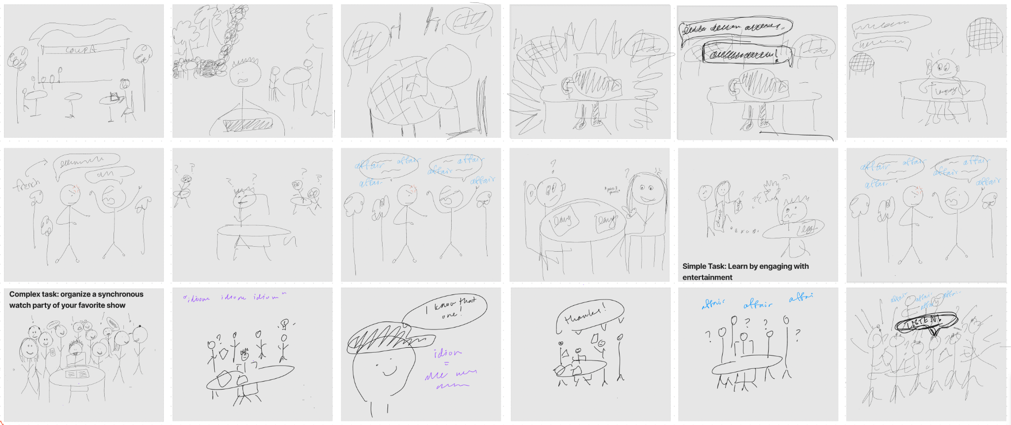
Scene setting: Matthew sitting at Coupa, feeling frustrated by his French textbook.
Suddenly, a loud conversation in French can be heard, piquing Matthew’s interest.
As the conversation continues, strangers surrounding Matthew are also intrigued.
An unknown word keeps being said, it’s preventing the eavesdroppers from understanding what’s being talked about.
The crowd and Matthew work together to piece together parts of the conversation, crowdsourcing everyone’s French knowledge.. The crowd gets louder and louder until Matthew tells everyone to focus on listening.

Slide 30
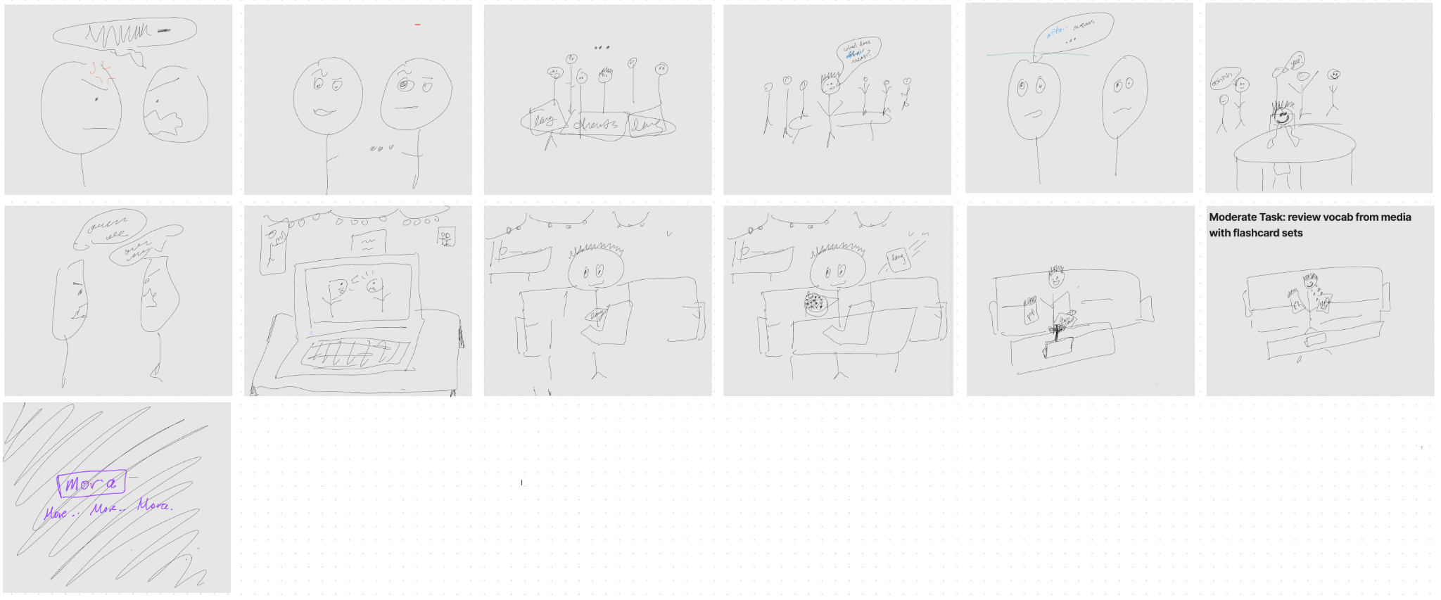
The confusing, unknown word is finally revealed by the French speakers and full context is finally revealed. The crowd is relieved and cheers, now with knowledge of new French idioms and vocabulary.
Plot twist! The French conversation didn’t actually happen! Everyone’s actually tuning in and learning French through their devices!

Slide 31
06
Concept Video
https://www.youtube.com/watch?v=joH6rJkoEeQ

